Slide 1
Semantic Web and Ontology
An Emerging Successor of the Web

Slide 2
Overview
Introduction
Expressing Meaning
Knowledge Representation
XML
RDF
Ontologies
Incremental Ontology Creation
Agents
Evolution of Semantic Web
Advantages
Conclusion

Slide 3
Introduction
The development of Semantic Web is well underway with a goal that it would
be possible for machines to understand the information on the web rather than
simply display.
The major obstacle to this goal is the fact that most information on the web is
designed solely for human consumption. This information should be structured
in a way that machines can understand and process that information.
The concept of machine-understandable documents does not imply “Artificial
Intelligence”. It only indicates a machine’s ability to solve well-defined
problems by performing well-defined operations on well-defined data.
The key technological threads that are currently employed in the development
of Semantic Web are: eXtensible Markup Language (XML), Resource
Description Framework (RDF), DAML (DARPA Agent Markup Language).

Slide 4
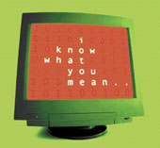
Expressing Meaning
Most of the web’s content today is designed for humans to read , and not for
computer programs to process meaningfully.
Computers can
- parse the web pages.
- perform routine processing (here a header, there a link, etc.)
In general, they have no reliable way to understand and process the semantics.
The Semantic Web will bring structure to the
meaningful content of the web of web pages,
creating an environment where software agents
roaming from page to page carry out sophisticated
tasks for users.
The Semantic Web is not a separate web.

Slide 5
Knowledge Representation
For Semantic Web to function, the computers should have access to
Structured Collections of Information
Meaning of this Information
Sets of Inference Rules/Logic.
These sets of Inference rules can be used to conduct automated reasoning.
Technological Threads for developing the Semantic Web:
- XML
- RDF
- Ontologies

Slide 6
XML
XML lets everyone to create their own tags.
These tags can be used by the script programs in sophisticated ways to
perform various tasks, but the script writer has to know what the page
writer uses each tag for.
In short, XML allows you to add arbitrary structure to the documents but
says nothing about what the structures mean.
It has no built mechanism to convey the meaning of the user’s new tags to
other users.

Slide 7
RDF
A scheme for defining information on the web. It provides the technology for
expressing the meaning of terms and concepts in a form that computers can
readily process.
RDF encodes this information on the XML page in sets of triples. The
triple is an information on the web about related things.
Each triple is a combination of Subject, Verb and Object, similar to an
elementary sentence.
Subjects, Verbs and Objects are each identified by a URI, which enable
anyone to define a new concept/new verb just by defining a URI for it
somewhere on the web.

Slide 8
RDF (contd.)
These triples can be written using XML tags as shown,
<contact rdf:about=“edumbill”> <name>Edd Dumbill</name> <role>Managing Director</role> <organization>XML.com</organization> </contact>
Subject | Verb | Object
doc.xml#edumbill | http://w3.org/1999/02/22-rdf-syntax-ns#type | http://example.org/contact
doc.xml#edumbill | http://example.org/name | “Edd Dumbill”
doc.xml#edumbill | http://example.org/role | “Managing Director”
doc.xml#edumbill | http://example.organization | “XML.com”
An RDF document can make assertions that particular things (people, web
pages or whatever) have properties ( “is a sister of”, “is the author of”) with
values (another person, another person, etc.)
RDF uses a different URI for each specific concept. Solves the problem of
same definition but different concepts. Eg. AddressTags in an XML page.

Slide 9
Ontologies
Ontologies are collections of statements written in a language such as RDF
that define relations between concepts and specifies logical rules for
reasoning about them.
Computers/agents/services will understand the meaning of semantic data on
a web page by following links to specified ontologies.
Ontologies can express a large number of relationships among entities
(objects) by assigning properties to classes and allowing subclasses to inherit
such properties.
An Ontology may express the rule,
If City Code State Code
and Address City Code then Address State Code
Enhances the functioning of semantic web: Improves accuracy of web
searches, Easy development of programs that can tackle complicated queries.

Slide 10
Incremental Ontology Creation
Your Web Page
www.petshop.com
o1
Feline of type f2
Your own ontology page
We sell animals
Animals of type feline
o2
Oa
Animals of type canine
F1 is popular
Feline of type f1
F1 is exotic
Pages from a web ontology repository
http://www.daml.org/ontologies
The meaning of the terms or XML codes used on a web page can be defined
by pointers (markup not displayed by a typical browser) from the page to an
ontology page.
Problem: Same concept different definitions.
E.g. One ontology defines : Address contains Zip Code.
Other ontology defines : Address contains Postal Code.
Resolved: If ontologies provide equivalence relations, i.e one or both
may contain the information that “Zip Code is Equivalent to Postal Code”

Slide 11

Agents
A piece of software that that runs without direct human control or constant
supervision to accomplish goals provided by the user.
Software Agents can
- collect web content from diverse sources.
- process that information and exchange the results with
other programs(agents).
- also exchange proofs “proofs” written in Semantic
Web’s Unified Language. Eg. Verify Cook’s place.
(UL : A language that expresses logical inferences made using rules and
information such as those specified by ontologies.)
Online Services
Where is cook?
Cook is in Missouri
Proof ?
Proof, doubts?
No

Slide 12
Agents
Digital Signatures are another vital feature, which are encrypted blocks of data
that computers and agents can use to verify that the attached information has
been provided by a specific trusted source.
Existing Automated Web-based Services:
- have no semantics.
- agents/programs cannot locate a service that will perform a specific function.
The Semantic Web is more flexible :
- We can have a common language to describe a service.
- The consumer agents and producer agents can reach a shared understanding by
exchanging ontologies, which provide the vocabulary needed for discussion.
- Web-Services and agents can advertise their functions by depositing such
information in directories analogous to the Yellow Pages.

Slide 13
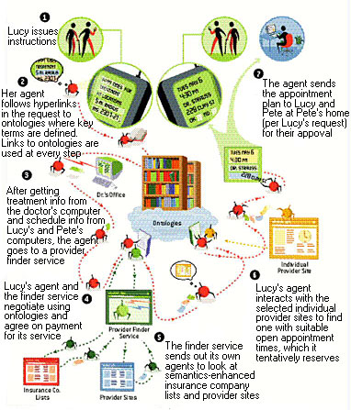
SOFTWARE AGENTS will be greatly facilitated by semantic content on the Web. In the depicted scenario, Lucy's agent tracks down a physical therapy clinic for her mother that meets a combination of criteria and has open appointment times that mesh with her and her brother Pete's schedules. Ontologies that define the meaning of semantic data play a key role in enabling the agent to understand what is on the Semantic Web, interact with sites and employ other automated services.

Slide 14
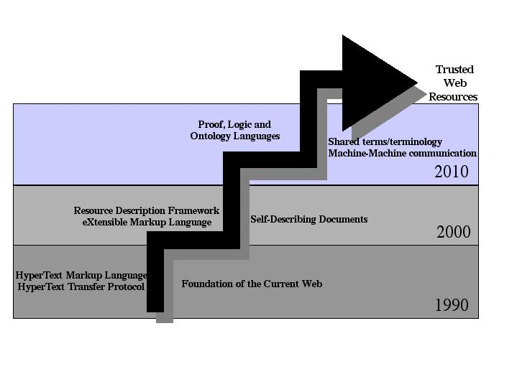
Evolution of Semantic Web

Slide 15
Advantages
Automated Tools
Enhanced Web Services
Effective Searching
Quality issues
Trust Issues

Slide 16
Conclusion
The semantic web in naming every concept simply by a URI, lets everyone
express new concepts that they invent with minimal effort.
Its unifying modeling language will enable these concepts to be progressively
linked into a universal web.
The structure of semantic web will open up the knowledge and workings of
human kind to meaningful analysis by software agents, providing a new class
of tools by which we can live, work and learn together.

